Slide 1
Spring Security

Slide 2
What is Spring Security?
Spring Security is a Java/Java EE framework that provides authentication, authorization and other security features for enterprise applications. The project was started in late 2003 as 'Acegi Security' by Ben Alex, with it being publicly released under the Apache License in March 2004.
Authentication is the process of verifying the identity of a person or device. A common example is entering a username and password when you log in to a website.
Authorization ​is the process to allow authority to perform actions in the application
Spring Security framework supports wide range of authentication models.
● LDAP (Lightweight Directory Access Protocol)
● Single sign-on
● JAAS (Java Authentication and Authorization Service) Login Module
● Basic Access Authentication
● Digest Access Authentication
● HTTP Authorization

Slide 3
HTTP BASIC Authentication
Basic access authentication is a method for an HTTP user agent (e.g. a web browser) to provide a user name and password when making a request. In basic HTTP authentication, a request contains a header field in the form of Authorization: Basic <credentials>, where credentials is the base64 encoding of id and password joined by a single colon :.
HTTP Basic authentication (BA) implementation is the simplest technique for enforcing access controls to web resources because it does not require cookies, session identifiers, or login pages; rather, HTTP Basic authentication uses standard fields in the HTTP header.
Spring Security Advantages
1.Proven technology, it’s better to use this than reinvent the wheel. Security is something where we need to take extra care, otherwise our application will be vulnerable for attackers.
2.Prevents some of the common attacks such as CSRF, session fixation attacks.
3.Easy to integrate in any web application. We don’t need to modify web application configurations, spring automatically injects security filters to the web application.
4.Provides support for authentication by different ways – in-memory, DAO, JDBC, LDAP and many more.
5.Provides option to ignore specific URL patterns, good for serving static HTML, image files.
6.Support for groups and roles.

Slide 4
Spring Security
Default Security Setup In order to add security to our Spring Boot application, we need to add the security starter dependency:
<dependency>
<groupId>org.springframework.boot</groupId>
<artifactId>spring-boot-starter-security</artifactId>
</dependency>
By default, the Authentication gets enabled for the Application. Also, ​content negotiation​ is used to determine if basic or formLogin should be used. By default, the Spring Boot behavior is the opposite: all endpoints require authorization.
SecurityBuilder used to create an AuthenticationManager. Allows for easily building in memory authentication, LDAP authentication, JDBC based authentication, adding UserDetailsService, and adding AuthenticationProvider's

Slide 5
@EnableWebSecurity​
The ​@EnableWebSecurity​ is a marker annotation. It allows Spring to find (it's a @Configuration​ and, therefore, ​@Component​) and automatically apply the class to the global WebSecurity​.
WebSecurityConfigurerAdapter provides a set of methods that are used to enable specific web security configuration.
configureGlobal() method configures the AuthenticationManagerBuilder class with the valid user credentials and the allowed roles.
We have configured JDBC Authentication and set up two queries for AuthenticationManagerBuilder
usersByUsernameQuery –> Authenticating the user
authoritiesByUsernameQuery –> Authorizing the user
@Autowired
public void configureGlobal(AuthenticationManagerBuilder auth) throws Exception {
auth.jdbcAuthentication().dataSource(dataSource)
.authoritiesByUsernameQuery("select USERNAME, ROLE from EMPLOYEE where USERNAME=?")
.usersByUsernameQuery("select USERNAME, PASSWORD, 1 as enabled from EMPLOYEE where USERNAME=?");
}
configure() method configures the HttpSecurity class which authorizes each HTTP request which has been made. In our example all the request will be authenticated and allowed access only when the user has USER or ADMIN role
.httpBasic() –> Makes spring to use the HTTP Basic Authentication method to authenticate the user
authorizeRequests()
.anyRequest().authenticated() –> All requests to the endpoint must be authorized
.csrf().disable() –> Disables CSRF protection

Slide 6
What is DataSource
A datasource is a factory for connections to any physical data source. An alternative to the DriverManager facility. It uses a URL along with some credentials to establish a database connection.
An object that implements the javax.sql.DataSource interface will typically be registered with JNDI service and can be discovered using it’s JNDI name.
A datasource may be used to obtain :
standard Connection object
connection which can be used in connection pooling
connection which can be used in distribured transactions and connection pooling
# H2 Configuration :
spring.datasource.url=jdbc:h2:mem:testdb
spring.datasource.driverClassName=org.h2.Driver
spring.datasource.username=sa
spring.datasource.password=password
spring.jpa.database-platform=org.hibernate.dialect.H2Dialect

Slide 7
User Schema:-
The standard JDBC implementation of the ​UserDetailsService​ (​JdbcDaoImpl​) requires tables to load the password, account status (enabled or disabled) and a list of authorities (roles) for the user. You will need to adjust this schema to match the database dialect you are using.
create table users(
username varchar_ignorecase(50) not null primary key,
password varchar_ignorecase(50) not null,
enabled boolean not null
);
create table authorities (
username varchar_ignorecase(50) not null,
authority varchar_ignorecase(50) not null,
constraint fk_authorities_users foreign key(username) references users(username)
);
create unique index ix_auth_username on authorities (username,authority);

Slide 8
Code Explanation :-
In configureGlobal() method, we have added two users: One user with “ROLE_USER” role and another user with both “ROLE_USER” and “ROLE_ADMIN” roles.
We can use either authorities(ROLE) or roles(ROLE) methods to configure Roles in our application.
Difference between authorities() and roles() methods:
1.authorities() needs complete role name like “ROLE_USER”
2.roles() needs role name like “USER”. It will automatically adds “ROLE_” value to this “USER” role name.
In configure() method, we have defined different URLs with required Access Roles.
-------------------------------------------------------------------------------------------------------------------------------------------------------------------------------------
Prior to Spring Security 5.0, the default PasswordEncoder was NoOpPasswordEncoder which required plain text passwords but is insecure. Spring Security 5.x onwards, the default PasswordEncoder is DelegatingPasswordEncoder, which requires a Password Storage Format.
Password Storage Format
The general format for a password is:
{id}encodedPassword
where:
"id“ is an identifier used to look up which PasswordEncoder should be used.
"encodedPassword“ is the original encoded password for the selected PasswordEncoder.

Slide 9
UserDetailsService
public interface ​UserDetailsService
Core interface which loads user-specific data.
UserDetailsService means a central interface in Spring Security. It is a service to search "User account and such user's roles". It is used by the Spring Security everytime when users log in the system. Therefore, you need to write a class to implement this interface.
Herein, I create the UserDetailsServiceImpl class which implements the UserDetailsService interface. The UserDetailsServiceImpl class is annotated by @Service to tell the Spring "let's manage it as a Spring BEAN".
When the user information is stored in a database, Spring provides two ways to authenticate:
● UserDetailService
● JDBCAuthentication

Slide 10
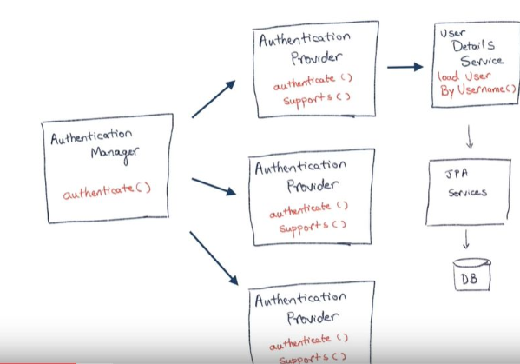
Internal working

Slide 11
Most commonly used PasswordEncoders with their id’s are:-
"noop" which uses plain text NoOpPasswordEncoder
"bcrypt" which uses `BCryptPasswordEncoder'
"scrypt" which uses SCryptPasswordEncoder
"pbkdf2" which uses 'Pbkdf2PasswordEncoder'
"sha256" which uses StandardPasswordEncoder
https://spring.io/projects/spring-security
https://springbootdev.com/2017/08/30/difference-between-secured-rolesallowed-and-preauthorizepostauthorize/

